Slide 1
Decentralized Real estate application using blockchain

Slide 2
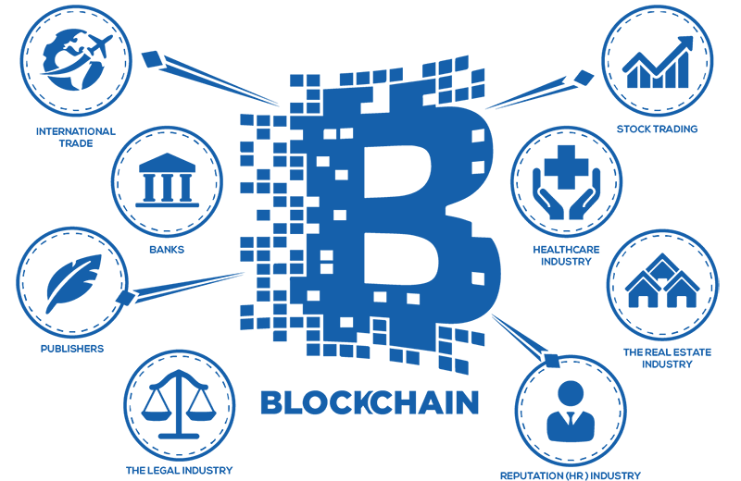
Introduction
What is a blockchain?
What is a ledger?
Smart Contracts

Slide 3
Problem statement
Principle of distributed ledger
Transparency in real estate

Slide 4
FLOW OF MODULES
Module 1:- ERC20 TOKEN
Module 2:- ETHEREUM WALLET
Module 3:- FRONT END TO BLOCKCHAIN WITH ETHERS.JS

Slide 5
Objectives
Trust between the parties
Transparency in the system
To reduce paperwork and its related costs

Slide 6
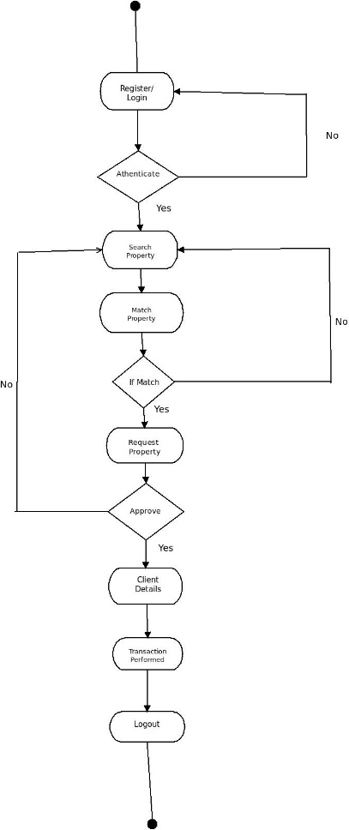
ACTIVITY DIAGRAM

Slide 7
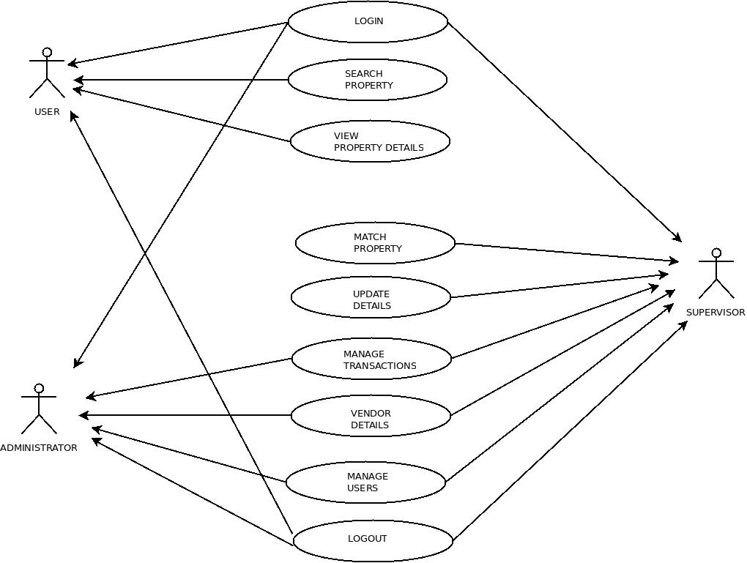
USE CASE DIAGRAM

Slide 8
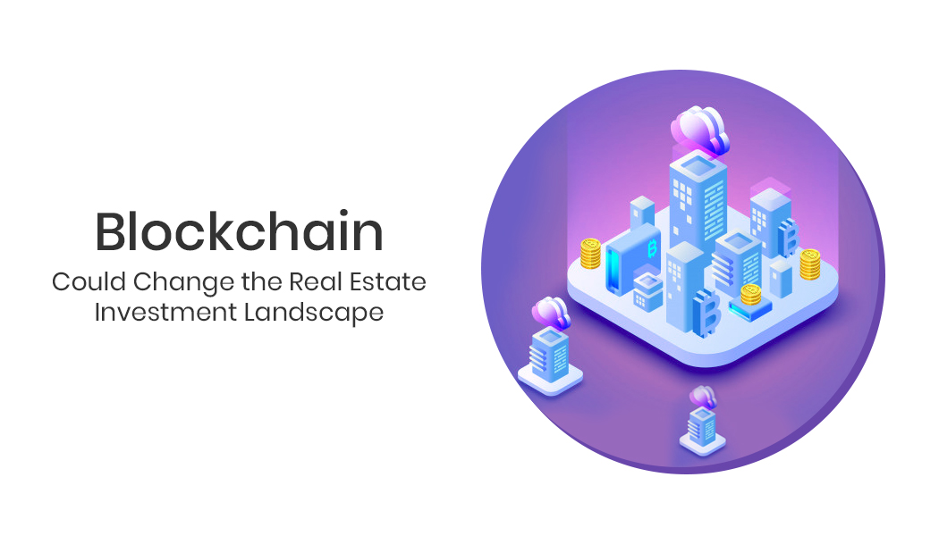
scope
Blockchain based website
Establish registration transparency
Use of ERC20 token

Slide 9
Benefits for Society
Curbs fraudulent registration
Establishes trust between the parties
Reduces registration cost

Slide 10
applications
Managing Records
Maintains financial privacy and speeds up the transactions
Real estate management, Insurance companies and even in health care

Slide 11
Technology stack
Ethereum
NodeJs
Solidity
Ethers.js
TestNets
MetaMask
FrontEnd

Slide 12
THANK YOU!!!

